Slide 1


Veteran & New
Farmer Program
Raised Bed Gardening
Mark Acosta, Frank Cruz and L. Robert Barber
University of Guam Cooperative Extension Service
Support from:

Slide 2
What is Raised Bed Gardening?
It is gardening in soil beds built up or mounded above the existing ground level.
  Raising soil level provides a deeper root zone
    Easier to modify the soil structure in the more limited area of the raised bed.
      Can add mulch, compost, manure, or sand.
    Improved soil structure allows raised beds to be managed more intensively.

Slide 3
Improvements to Raised Beds
Incorporate organic matter, use mulch, compost, or manure.
  This improves soil structure, water holding capacity, and adds soil nutrients
Improve drainage by adding sand or other large (relative to clay) particle material.
  Open up compact (clay), poorly drained soils to air and water flow.
Properly constructed raised beds create an area of rich soil where none currently exists.

Slide 4
Advantages of Raised Beds
Longer Growing Season:
  By improving soil drainage the raised bed dries out faster in wet season.
    Allows growing crops during rainy season that might not other wise be possible
Higher Yields; Because of improved soil fertility, depth and structure.
  More plants can be grown in a smaller area.
  Better root growth with improved structure, depth, plant growth, air, and water
Maintenance:
  Planting closer together reduces weed growth by shading out weeds

Slide 5
Disadvantages Of Raised Beds
Increased plant density requires more water per unit area.
Can be expensive, if materials have to be purchased.
Increased plant density, may increase pest/disease concerns.

Slide 6
Designing Your Raised Bed
Where do you want to put your bed?
  Good sunlight? Is water near?
If constructing more than one bed, plan for paths between the beds.
Mark the dimensions of the bed.
Do you want temporary or fixed beds?

Slide 7
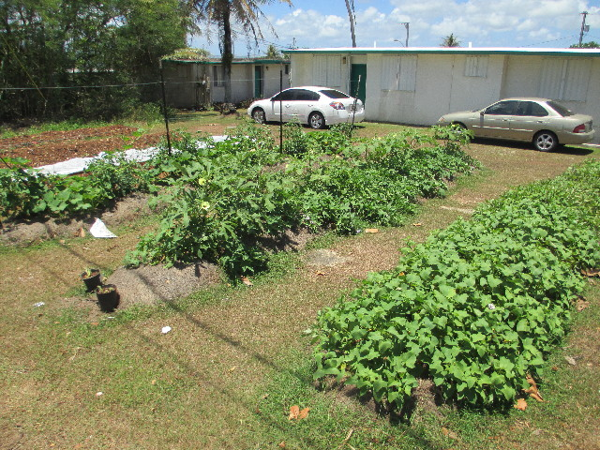
Temporary Raised Beds/Mounds

Slide 8
Temporary Raised Beds/Mounds
No frames, so less labor & materials required.
Beds will flatten over time as the soil settles, and erodes because there is no wall support.
Dig and turn the soil in a 4-6’ wide area
  The deeper the better
Mix soil amendments to the full depth
Pull soil in from each side of the bed, mounding it up in the center, creating a 3-4’ bed.
You now have a raised bed with improved soil quality, compared to the surrounding soil.

Slide 9
Fixed Raised Beds
Have walls that can be built using:
  Mortared bricks or stones
  Cement blocks or
  Rot resistant wood
    Do not use wood containing creosote or compounds containing pentachlorophenol
    Organic farmers cannot use treated wood
  Recycled Tires
If walls are more than 6-8” they need to be secured (fastened or mortared).

Slide 10
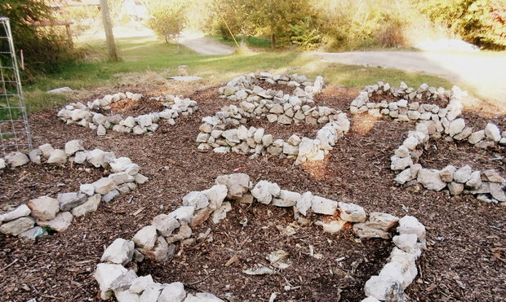
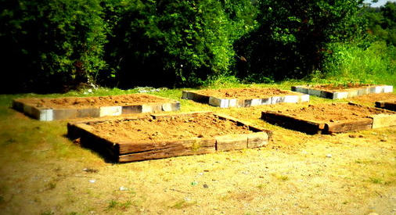
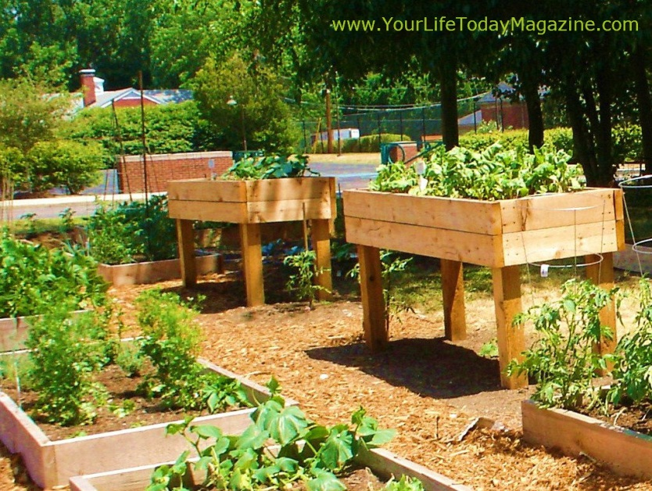
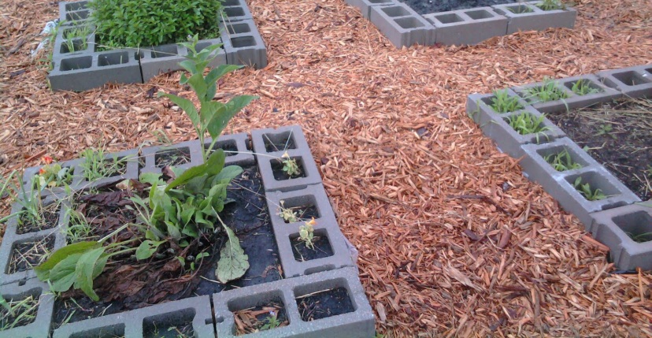
Fixed Raised Beds

Slide 11
Materials Needed For Fixed Beds
Cinder Blocks, Timber, Recycled Tires or Rock for Walls
Measuring Tape and Shovels
Cardboard, News Paper, or Paper Bags
Sand (WMS Manufacturing Sand) - Optional
Mulch or Compost,
Fertilizer or Manure (Chicken or Steer)

Slide 12
Concerns in Building Fixed Raised Beds
Beds should be wide enough so you can reach the center from the sides.
  Arms are only so long, so bed width for adults 4’ max, children 3’ max.
Beds should be at least 6” high
  Plants grow best in 6-12” of soil
Dig/loosen the soil below the frame,
Lay down an organic weed barrier or kill weeds before construction
    Cardboard, newspaper or paper bags
Add new soil, organic matter or other amendments (leave room at the top for mulch).

Slide 13
Soil Mix
To loosen clay soils or open air space:
  Mix up to 1/3 existing soil, 1/3 compost, mulch or peat & 1/3 coarse sand
In sandy soils, adding organic matter and clay soils will increase water holding capacity in a similar manner.
  Mix up to 1/3 sandy soil, 1/3 compost, mulch or peat & 1/3 clay or silt.
Also mix in manure, fertilizer or other materials to increase nutrients.

Slide 14
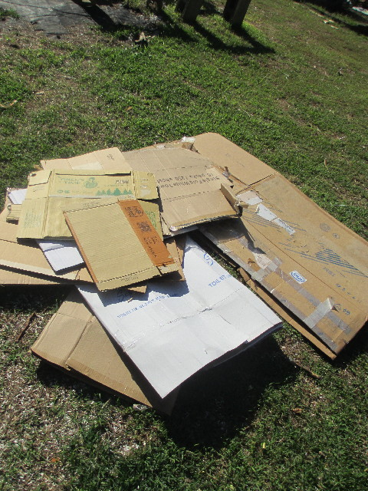
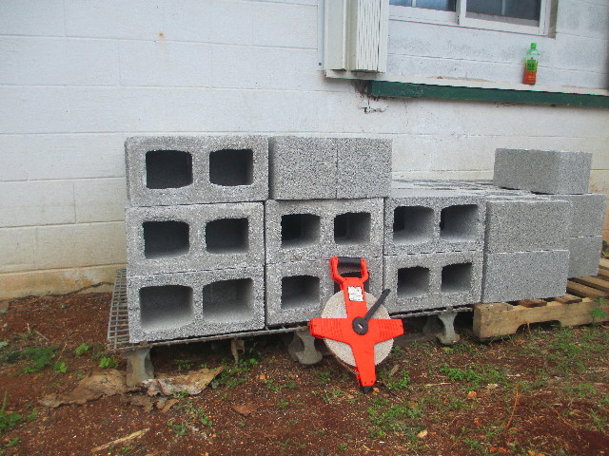
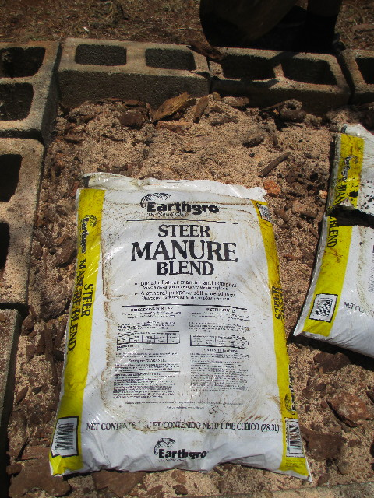
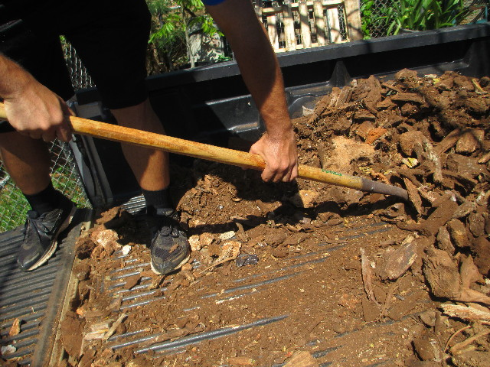
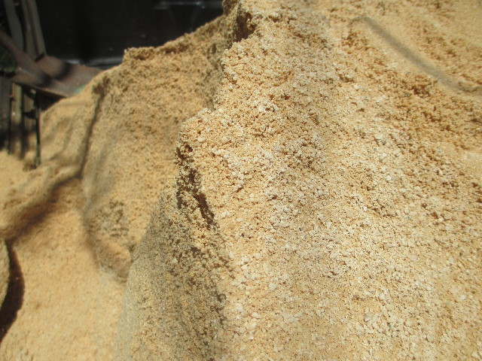
Steps to Making Raised Beds
Gather Materials
  Cardboards
  Blocks
  Mulch
  Sand
  Fertilizer

Slide 15
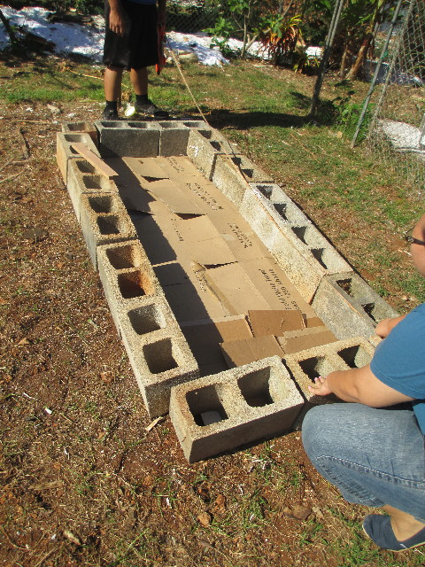
Steps to Making Raised Beds
Measure desired bed size
  3’ wide (Children’s Bed)
  4’ wide (Adult’s Bed)
Level wall base
Lay cardboard or sheets of paper on top of grass as a weed barrier
  If weed barrier is thick- need to punch holes
Place cement blocks over cardboard

Slide 16
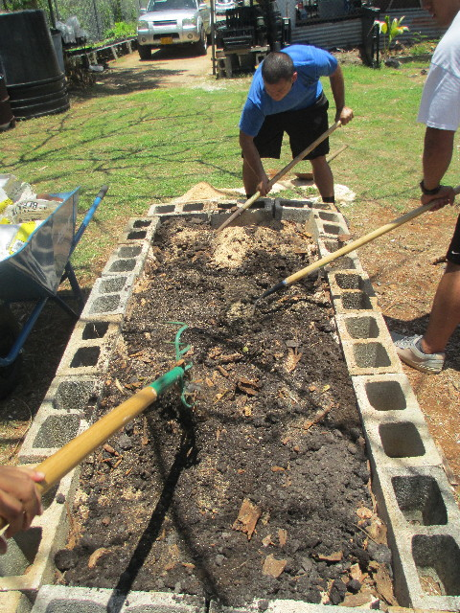
Steps to Making Raised Beds
Fill bed with soil mix
  Mulch
  Compost
  Coarse Sand
  Existing Soil
  Manure (Other Organic Matter Sources)
  Potting Soil

Slide 17
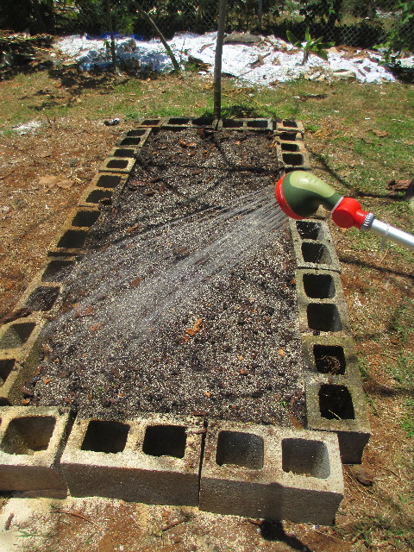
Steps to Making Raised Beds
Water bed thoroughly before planting
  Drip Irrigation
  Sprinkler
  Hand Watering

Slide 18
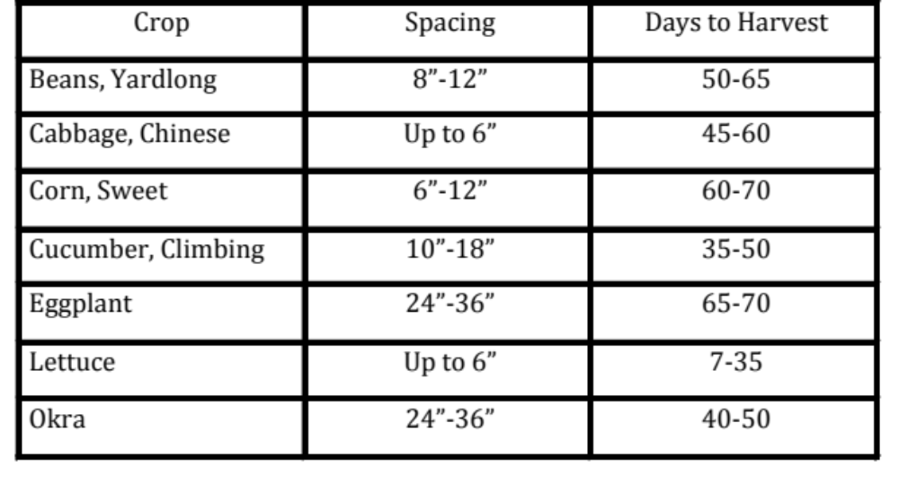
Vegetable Spacing in Beds
*Leafy greens (Cabbage, Lettuce, & Pechay) can be planted in a continuous strip and harvested to thin them out.

Slide 19
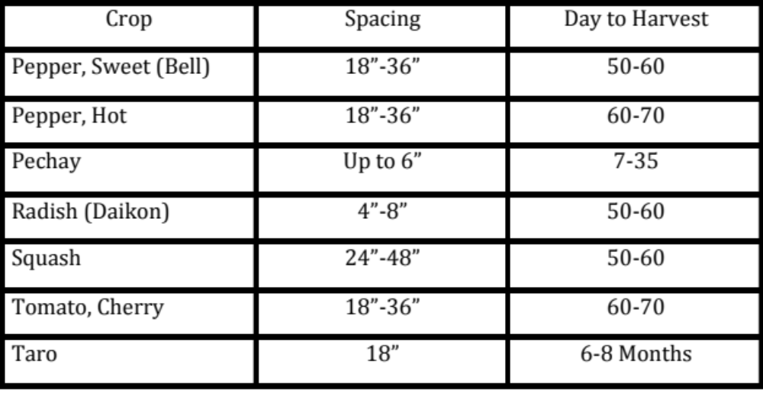
Vegetable Spacing in Beds
*Leafy greens (Cabbage, Lettuce, & Pechay) can be planted in a continuous strip and harvested to thin them out.

Slide 20
Interplanting Spacing Equation
To determine the spacing for interplanting between different plant species, add the recommended spacing for the two crops to be planted together, and divide their sum by 2.
For example: Radishes = 2” ; Beans= 4”
  2” + 4” = 6, then 6” divided by 2 = 3”
  Radishes should be planted 3” from the beans
Plant your crop, water, lay down a weed suppressing mulch and watch them grow.

Slide 21
Conclusion
Raised bed possibilities are endless
Design of raised beds depends on the gardeners resources/goals
If you invest time needed for construction you can obtain:
  Better drainage and improved soil structure
  Increased moisture retention and soil fertility
  Improved plant growth.

Slide 22
References
Building a Raised Bed Vegetable Garden: The Easy Way, http://miami-dade.ifas.ufl.edu/lawn_and_garden/Building%20a%20Raised%20Bed%20Vegetable%20Garden%20The%20Easy%20way.pdf
Intensive Gardening Methods,
http://pubs.ext.vt.edu/426/426-335/426-335_pdf.pdf
Raised Bed Gardening, http://www.aces.edu/pubs/docs/A/ANR-1345/ANR-1345.pdf

